Slide 1

BHS Project 2026 – How to Protect your Bridleways?
Bookham Riding Club – Virtual AGM
Monday, 22nd February 2021
BHS Surrey Access Committee

Slide 2
Countryside Rights of Way Act - 2000
In 2000 the CR0W (Countryside Rights of Way) Act was passed by Parliament, which in layman's terms meant that the clock had started ticking to ensure all lost (unrecorded) Rights of Way (RoW) in England and Wales are officially recorded. Scotland have their own Right to Roam laws.
Different types of Rights of Way:-
Footpath - used by Walkers (yellow marker)
Bridleway – used by above and Horse Riders and Cyclists. (blue marker)
Restricted Byway – used by above plus Carriage Drivers (non-Motorised) (red marker)
Byway Open to All Traffic (BOAT) – can be used by above plus Motorised Vehicles.
All of the above Rights of Way are highways and generally governed by the same legislation. The difference between them and roads are who by and how they are maintained.

Slide 3
Cut off date … 1 Jan 2026
The Countryside and Rights of Way (CROW) Act 2000:-
Introduced a cut-off date of 1st January 2026 to close the Definitive Map of public rights of way.
Any Bridleways and other rights of way that were in existence in 1949 which are not recorded by 1 January 2026 will be lost forever.
The understanding behind the cut of date was that the historic RoW network would have been researched and recorded by this date, but this is clearly unachievable.
Why is this unachievable?
No Government funding.
Research is carried out mainly by volunteers (who often have full time jobs) and thus limited time available.

Slide 4
Definitive Map (DM)
All our Rights of Way eg our Bridleways, are only protected if they are shown on the Definitive Map.
What is the Definitive Map? The map of all registered Rights of Way (RoW). A hard copy is held at each county council office and most counties (eg Surrey CC) have an on-line version. http://surreymaps.surreycc.gov.uk/public/viewer.asp
The Ordnance Survey Map is derived from the Definitive Map, and can be used as a good starting point for checking RoW. Some of our Bridleways, which riders have ridden for years, are not listed on the Definitive Map. Just because there is a Fingerpost Sign does NOT mean that it is on the Definitive Map eg Barwell Loop near Esher. Do not rely on the signage. Check your Bridleways are on the Definitive Map.
The exception to the above is Permissive Bridleways or Horse Rides. These are not on the Definitive Map and are used only with the landowners permission and can never be considered a Public Bridleway.
The BHS Project 2026 is about saving as many lost Bridleways as possible before the Government deadline of 1 Jan 2026. The BHS have created online training sessions to explain how horse riders, cyclists and walkers can assist in this research.

Slide 5
Definitive Map Modification Order - DMMO
The form to request that a track (eg unrecorded route) is put on the Definitive Map as a Public Bridleway, is known as a Definitive Map Modification Order (DMMO). There are two types of evidence needed for the DMMO. The BHS will help with both:-
Historical Evidence. This involves analyzing old maps eg Tithe Map, Finance Act Map and Enclosure Awards. If the maps are not on-line, research is required at the National Archives in Kew or Surrey Local History Centre in Woking.
User Evidence – This needs as many users as possible to show continuous usage without obstruction in a chosen 20 year period. They can be cyclists too, not just horse riders. Cyclists have only been allowed to use Bridleways since 1968.
The DMMO is then lodged with Surrey County Council Rights of Way team. If it complies with their legal criteria it is placed on the SCC Rights of Way DMMO register.

Slide 6
Definitive Map Modification Order – DMMO cont…/
The bad news is that most councils in England have a huge DMMO back log.
Surrey CC - 35 DMMOS on their register. This is a low number because very few people are submitting DMMOs in Surrey. DMMO progress on submitted ones is slow because SCC have had many staff cuts.
Hampshire CC - 171 DMMOs.
Somerset and other counties with extensive volunteer groups, have over 350 DMMOs.
Each DMMO can take years to look into. It a very time consuming job and local councils are under resourced and Covid has increased that delay. However, once a DMMO is submitted, even if it is not looked at before the 2026 deadline, it will be in the queue and will be looked at eventually.

Slide 7
Commons
And if you thought all that was confusing we haven’t even touched upon commons. If you ride on commons you might want to contact us directly as most commons in Surrey have a right for “air and exercise” or public recreation that includes horse riding which means you do not always have to ride on the set Bridleways. But each common is different and you would need to check your common’s Byelaws and the signage.

Slide 8
The Recorded Network
In England
117,000 miles of public rights of way, of which:-
22% are Bridleways
5% are byways and restricted byways
73% are almost all Footpaths. However, these maybe under recorded and possibly should be Bridleways or Byways. Historical research could result in DMMO upgrade to Bridleway (eg status change at a Parish boundary).

Slide 9
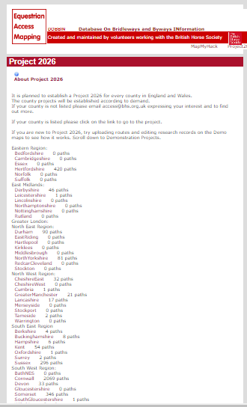
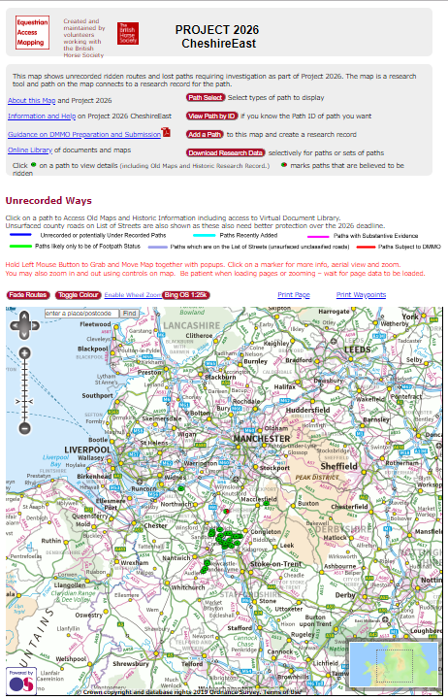
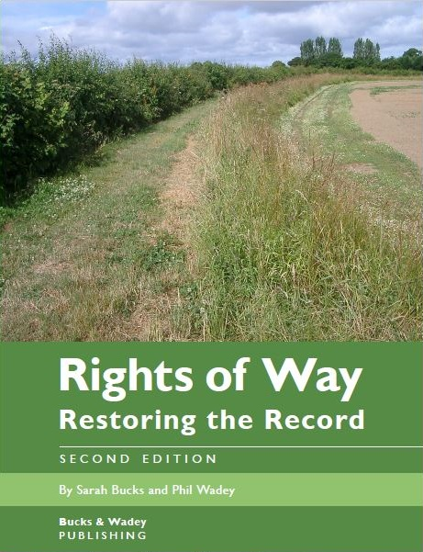
What is being done now?
Many people are already busy researching and submitting DMMO applications, some as individuals, most as part of a group eg BHS and Cycling Groups. The Ramblers too but they are mainly interested in Footpaths.
http://www.restoringtherecord.org.uk/
www.bhsaccess.org.uk/Project2026

Slide 10


What next?
In 2018 the BHS secured a £150K grant from Sport England through the British Equestrian Federation and matched that with £150K of their own funding.
BHS are offering a £100 payment towards your expenses for every eligible DMMO application (with historical evidence) submitted since 1 January 2018.
The applications need to match the BHS criteria, be accepted by the local authority and added to their statutory register
Keep an eye on the BHS website for updates and developments!

Slide 11
Project 2026 Website – paths identified on map v’s DMMOs submitted
South East Region
Berkshire 4 paths (0 submitted)
Buckinghamshire 30 paths (10 submitted)
Hampshire 110 paths (36 submitted)
IoW 2 paths (0 submitted)
Kent 202 paths (47 submitted)
MiltonKeynes 26 paths (3 submitted)
Oxfordshire 51 paths (0 submitted)
Surrey 59 paths (34 submitted)
Sussex 786 paths (60 submitted)

Slide 12
If you would like to know more about the
BHS Project 2026 website please visit the below link….
https://www.bhsaccess.org.uk/dobbin/Project2026.php

Slide 13
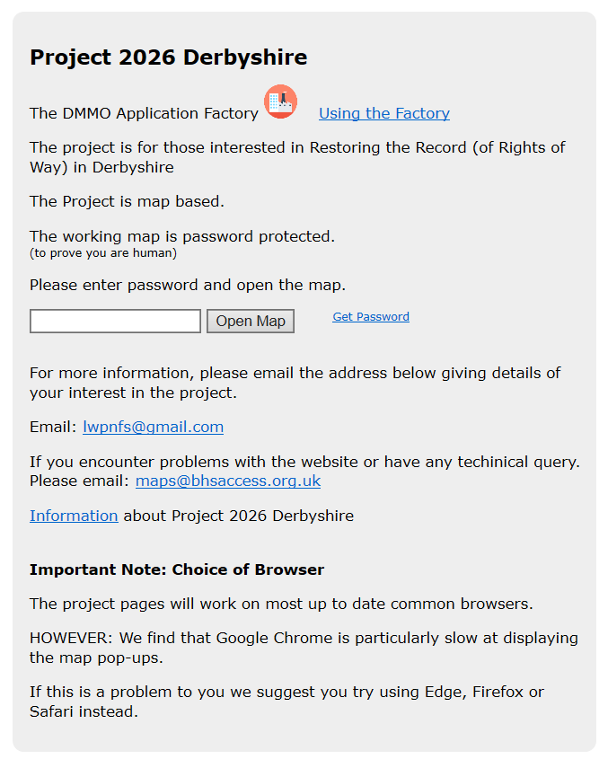
The Project 2026 Website
Password is 2026!

Slide 14
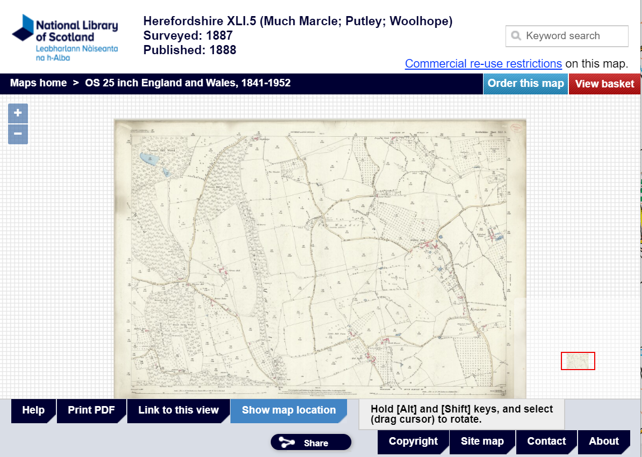
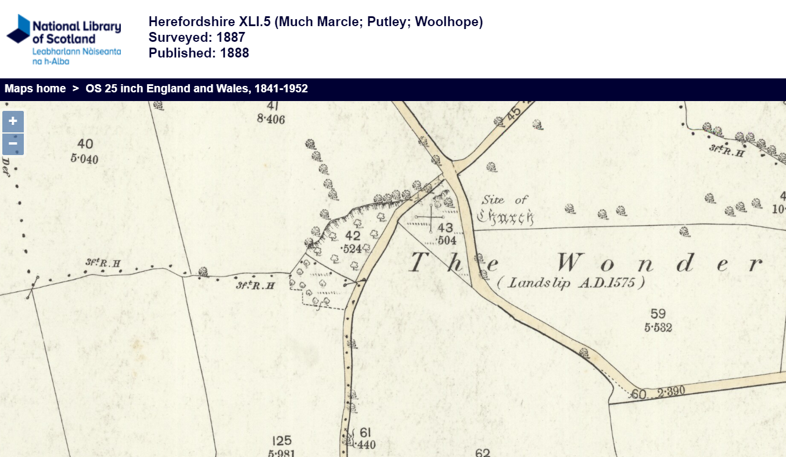
The Project 2026 Website – What the old maps section look like

Slide 15
Further information
Sarah Rayfield – Access Field Officer (for London, Surrey, Sussex, Kent) – 07971-059262 - sarah.rayfield@bhs.org.uk
Access & Bridleway Virtual drop in meeting – Tuesday 9 March at 7.30pm. Please contact Sarah Rayfield above. Access Virtual drop in Surrey | British Horse Society (bhs.org.uk)
The BHS have a 1 day access conference, usually middle of November, at their Head Office in Warwickshire. If you are interested in access matters in general sign up for the access news. For both these areas contact access@bhs.org.uk.

Slide 16
Surrey Bridleway Committee need volunteers
The BHS Surrey Access committee are always looking for volunteers. Even if you are just an extra pair of eyes & ears on your patch while riding your horse.
Your last volunteer for your area was Colin Sandford, but he has since retired, and we are now looking for somebody to support the area BRC falls within.
Other areas that we need help with are Reigate & Banstead. Currently nobody is covering this area. They have just launched their Local Plan and we are concerned that unrecorded Bridleways will be lost.
If you know anybody interested in historical maps or research please ask them to get in touch.

Slide 17
BHS membership - £7 per month
If you don’t have time to Volunteer then please do think about joining the BHS. Your membership goes towards a host
of other important projects:-
Training sessions on how to rescue bridleways or upgrade suitable Footpaths. Extending or abolishing 2026 cut-off. D regulation act.
Incident website - providing statistics to police for hotspot areas. (eg road accidents, dog attacks, fireworks, slippery roads, gates, Chinese lanterns etc).
Lobbying to the government, Defra, Forestry Commission & National Consultations for horses to be included eg cycle paths and other promoted routes.
Protecting Bridleways within planning applications.
£90k Bridleway funding for re-surfacing
£270k + Hardship fund to prevent Riding Schools and training establishments closing down due to lockdown.
The list goes on:- Pegasus crossings, permitted access, resurfacing Bridleways with Flexi pave or rubber crumb surface NOT tarmac (which is the default for many Local authorities now especially after Covid). Continued beach access, Public enquiry to keep Bridleways open, protecting Horse margins/verges, keep Railway crossings safe, Access to Common land. E-scooter issues, Tree growing strategies, Greenways routes eg Leith Hill, inclusion in Cycling initiatives, Safe rails on bridges, statistics for what horses bring to the local economy. Map reading skills etc.
And we haven’t even mentioned the insurance cover!!! ☺

Slide 18
Questions?
Please don’t leave it to somebody else to save your Bridleways. Most of us are volunteers.
Thank you for listening.

